Slide 1

NearYou
By : Ashna Pk &
Prajwal Gowda M M

Slide 2

Empowering Local Businesses with Digital Solutions
A Platform to Help Local Shops Thrive
Local businesses are the heartbeat of our communities, but they face fierce competition from larger chains and e-commerce. Our platform empowers these local shops with a suite of digital tools to boost their visibility and grow their customer base.

Slide 3
Introduction to Our Project
Background
Our Goal
Local businesses are essential to community economies, but they struggle to compete with the scale and convenience of larger chains and online retailers.
To provide local businesses with an easy-to-use digital platform that enhances their online presence and connects them with more customers.

Slide 4
Challenges Facing Local Businesses
1
Limited Online Visibility
2
Lack of Digital Expertise
Smaller shops struggle to compete with large chains and e-commerce giants in search and social media.
Many local business owners lack the time and resources to build and maintain an effective online presence.

Slide 5
Our Digital Platform
Easy-to-Use Tools
Robust Online Presence
Intuitive features like inventory management, online booking, and customer reviews make it simple for shop owners to engage customers.
Our platform gives local businesses a professional, integration to boost their online visibility.

Slide 6
Microservices:
Auth Api
Seller Api
Booking Api
Manages user, seller, and admin roles, allowing login and registration with role-based restrictions (admin cannot register).
Manages seller-specific data, including CRUD operations for products (add, update, delete).
Allows users to book products and enables sellers to view user bookings and reviews.
Public Api
GeoCoding and StreetMap :
For getting latitude and longitude and Street Directions.
Quotes : It generate random quotes on topic we specify
User Api
Handles CRUD operations for user data, admin has the authority to view and remove users and sellers

Slide 7

Key Platform Features
Seller Management
Customer Booking
Sellers can easily add and update their product listings, manage orders, and See the customer Reviews of particular product .
Customers can book the products which they like based on the availability of products and price through the platform.
Review System
Analytics Dashboard
Customers can leave reviews to build trust and help other shoppers make informed decisions.
Sellers receive insights on sales, and customer behavior to optimize their strategies.

Slide 8
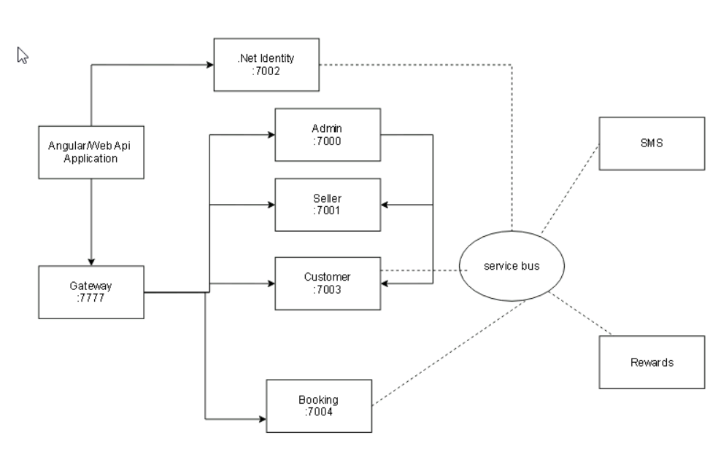
auth
Architecture Diagram

Slide 9
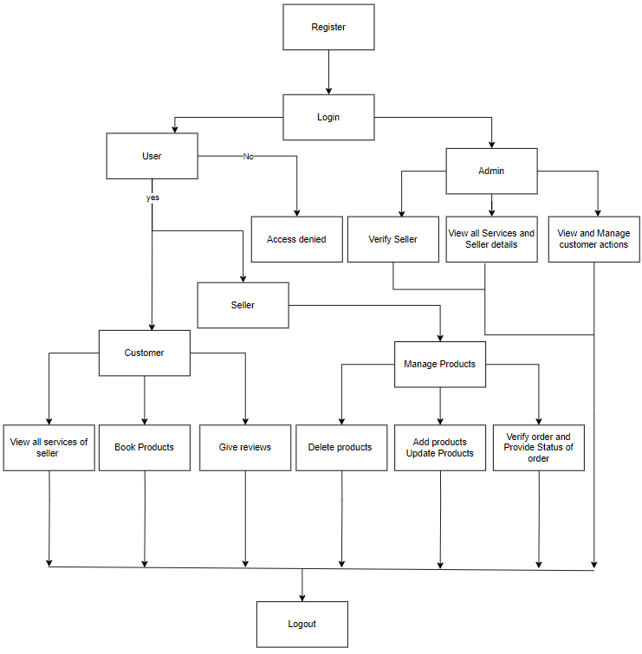
Control Flow Diagram

Slide 10
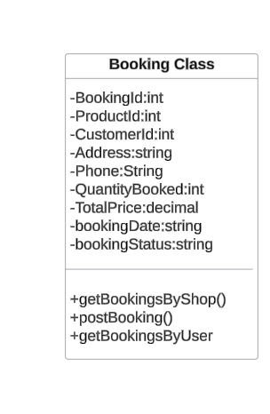
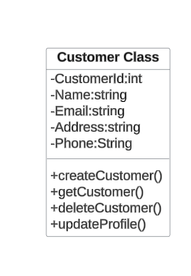
Class Diagrams :

Slide 11
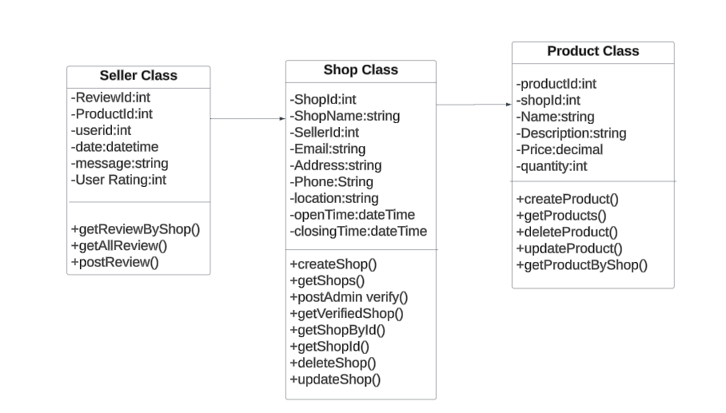
Class Diagrams :

Slide 12




User Roles
Admin
Seller
Customer
Oversees the platform, verifies sellers, and manages user accounts.
Adds and manages their product listings, processes orders.
Discovers local businesses, books Products, leaves reviews and give ratings with this platform.

Slide 13
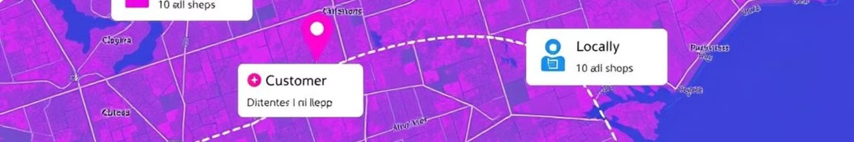
Connecting Customers and Shops
Customer Finds Shop
Leave Reviews
Customers can search for nearby businesses and view details like location, hours, and product offerings.
After their visit, customers can share their experience to help build trust and guide future shoppers.
1
2
3
Book
Customers can book the products which they like based on the availability of products and price through the platform.

Slide 14





Seller Onboarding and Management
1
Seller Registration
2
Product Listing
Sellers can add and update their product catalog.
3
Order Processing
Sellers receive and fulfill customer orders through the platform.
4
Customer Engagement
Sellers can View the customer reviews and manage their Products .
5
Performance Insights
Sellers access sales data and customer analytics to optimize their strategies.

Slide 15

The Future of Local Commerce
"When local businesses thrive, communities thrive."
Our digital platform is just the beginning. By empowering local shops with the tools and technology they need, we're confident that the future of commerce will be built on strong, vibrant communities.

Slide 16
Thank You
We appreciate your time and attention.

